Slide 1

v.0.0.1
Notes:
Version 0.0.9
Minor Styling Changes
Version 0.0.8
Added photos and design to the deck.
Added comments to each slide around talking points
Feedback on the deck? E-mail us at localhost@mlh.io !

Slide 2
Using your Web Browser,
Open this URL:
Click on the workshop you’re attending, and find:
1
http://mlhlocal.host/lhd-resources
2
Setup Instructions
The Code Samples
A demo project
A Workshop FAQ
These Workshop Slides
More Learning Resources
Notes:
What to Say:
Tell attendees we are going to check them in for the event
Once attendees check in, they will receive an email with the items listed on the slide
Attendees must check-in to get credit for attending this event
What to Do:
Confirm that everyone has checked in by asking participants to give you a signal when they receive the email.

Slide 3

Our Mission is to Empower Hackers.
65,000+
HACKERS
12,000+
PROJECTS CREATED
400+
CITIES
We hope you learn something awesome today!
Find more resources: http://mlh.io/
Notes:
What to Say:
Major League Hacking (MLH) events are meant to bring hackers together so they can learn, build, and share.
Give participants a brief overview of Major League Hacking (MLH).
Tell participants they can learn more at http://mlh.io/
Example Talking Points:
Major League Hacking is the official student hackathon league. They help organize the hackathon seasons in North America and Europe and support the 120,000 student hackers who participate annually in student hackathon including you at this event right now.
Here’s some quick facts about MLH:
Each year, MLH supports over 65,000 hackers around the world at events they facilitate
Those students create more than 12,000 amazing projects together
MLH is a global organization that empowers hackers in more than 400 cities and growing every day

Slide 4
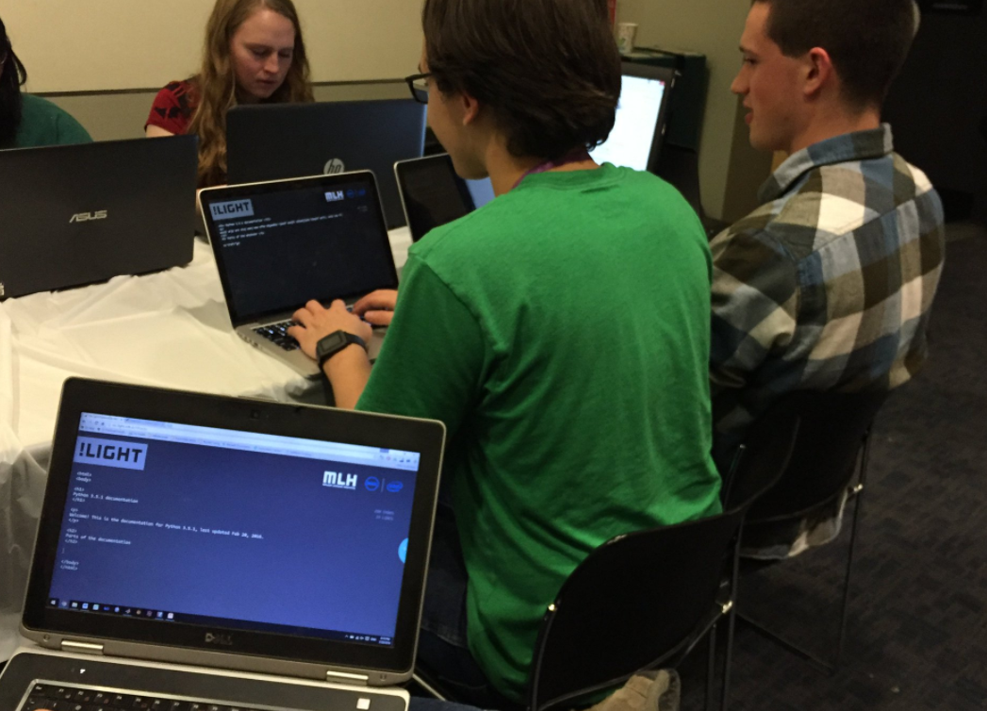
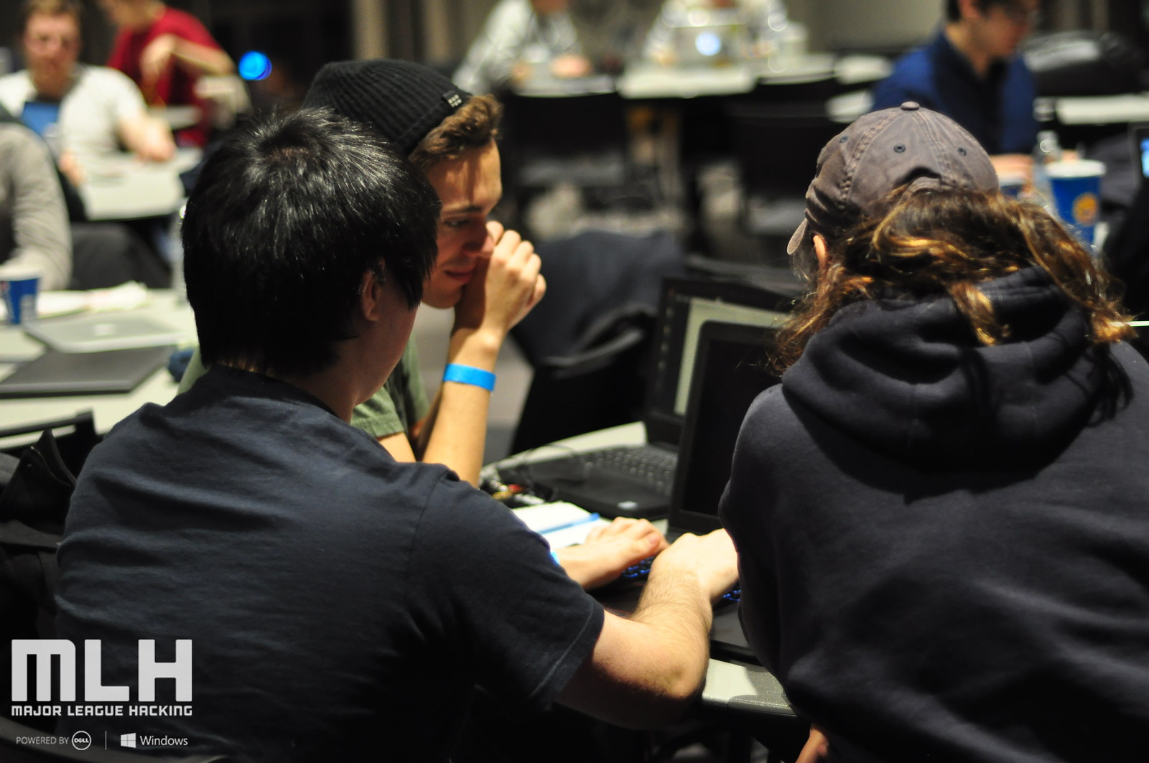
What is Slideshow Karaoke?
Slideshow Karaoke is a fun game where participants are called up to the stage one at a time. The audience will shout out topics and organizer will use those topic suggestions to find a random yet topical slide deck on the Internet. The participant on stage will then present the slide deck without getting to view the content. The organizer will keep time and progress the slidedeck as the participant makes their presentation.
Notes:
Find slides at https://www.slideshare.net/

Slide 5

Sign up for the MLH Career Lab!
http://mlhlocal.host/career-lab
Browse a curated list of hacker jobs.
Apply for jobs and internships from companies that want to recruit directly from the MLH community.
Receive updates and career advice from MLH!
Notes:
What to Say:
If you didn't sign up for the career lab during check-in, you can do so at anytime at the URL above!

